Slide 1
COMPLIANCE CONSULTING TOOLKIT
Here is where your presentation begins

Slide 2
CONTENTS OF THIS TEMPLATE
This is a slide structure based on a consulting toolkit presentation
You can delete this slide when you’re done editing the presentation
FONTS | To view this template correctly in PowerPoint, download and install the fonts we used
USED AND ALTERNATIVE RESOURCES | An assortment of graphic resources that are suitable for use in this presentation
THANKS SLIDE | You must keep it so that proper credits for our design are given
COLORS | All the colors used in this presentation
ICONS AND INFOGRAPHIC RESOURCES | These can be used in the template, and their size and color can be edited
EDITABLE PRESENTATION THEME | You can edit the master slides easily. For more info, click here
For more info: SLIDESGO | SLIDESGO SCHOOL | FAQs
You can visit our sister projects: FREEPIK | FLATICON | STORYSET | WEPIK | VIDFY

Slide 3
TABLE OF CONTENTS
01
02
PROJECT & STRATEGY
CONSULTING PROPOSAL
03
04
CHANGE MANAGEMENT
IMPLEMENTING CHANGES
You can describe the topic of the section here
You can describe the topic of the section here
You can describe the topic of the section here
You can describe the topic of the section here

Slide 4
—SOMEONE FAMOUS
“This is a quote, words full of wisdom that someone important said and can make the reader get inspired.”

Slide 5
01
PROJECT & STRATEGY
PROJECT
STRATEGY
You can enter a subtitle here if you need it

Slide 6
PROJECT & STRATEGY DEFINITION
You can give a brief description of the topic you want to talk about here. For example, if you want to talk about Mercury, you can say that it’s the smallest planet in the entire Solar System

Slide 7
STRATEGIC PLANNING PROJECT PLAN
STEPS |  |  | WEEK | 1 | 2 | 3 | 4 | 5 | 6 | 7 | 8 | 9 | 10
1. KICK-OFF
2. BUSINESS INSIGHTS
3. MISSION AND VISION
4. KEY STRATEGIC OBJECTIVES
5. STRATEGY MAP
6. BALANCED SCORECARD
7. STRATEGIC OBJECTIVES
8. FIRST REPORT

Slide 8
STRATEGIC PLANNING PROJECT PLAN
MISSION
VISION
OBJECTIVES
KEY INITIATIVES
Venus has a beautiful name and is the second planet from the Sun
Earth is the only one that harbors life in the Solar System
Despite being red, Mars is actually a cold place. It's full of iron dust
Jupiter is a gas giant and the biggest planet in the Solar System

Slide 9
STRATEGY MAP & BALANCED SCORECARD
PERSPECTIVES | OBJECTIVE A | OBJECTIVE B | OBJECTIVE C | OBJECTIVE D
FINANCIAL | Insert your text in here | Insert your text in here | Insert your text in here | Insert your text in here
CUSTOMER | Insert your text in here | Insert your text in here | Insert your text in here | Insert your text in here
INTERNAL PROCESS | Insert your text in here | Insert your text in here | Insert your text in here | Insert your text in here
LEARNING & GROWTH | Insert your text in here | Insert your text in here | Insert your text in here | Insert your text in here

Slide 10
STRATEGIC OPTIONS: RISKS
New
MARKET DEVELOPMENT STRATEGY
DIVERSIFICATION STRATEGY
Not recommended strategic options
Current
MARKET PENETRATION STRATEGY
PRODUCT DEVELOPMENT STRATEGY
Recommended strategic option
Current
New

Slide 11
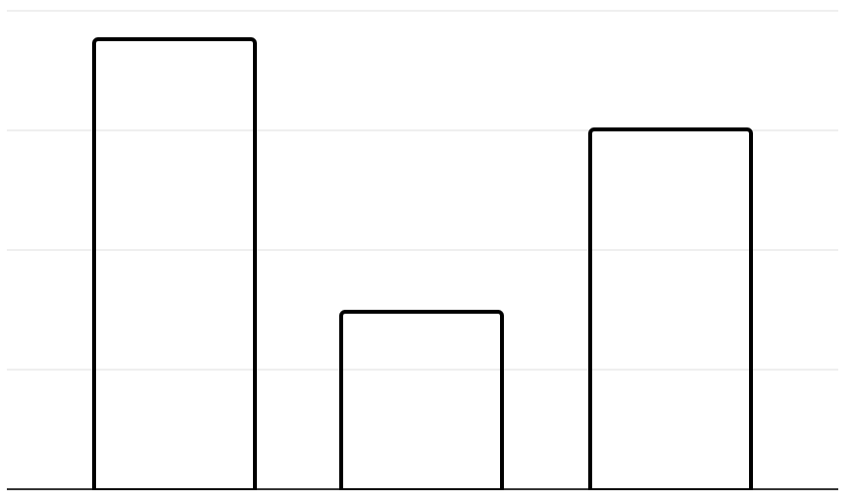
IMPACT OF THE RISKS
100
AREA A
Mercury is the closest planet to the Sun
75
50
AREA B
Venus has extremely high temperatures
25
0
Area A
Area B
Area C
AREA C
Follow the link in the graph to modify its data and then paste the new one here. For more info, click here
Earth is the only planet that harbors life

Slide 12
CORPORATE STRATEGIES
INSURANCE
BANKING
HEALTH
Neptune is the farthest planet from the Sun
The Sun is the star around which we all orbit
The Moon is Earth’s only natural satellite

Slide 13
KEY DRIVERS OF THE PROFIT
 | DESCRIPTION | EXAMPLE
THE SITUATION | A neutral description with agreeable facts | Our company has been selling for 10 years
THE COMPLICATION | It is a desired change of the current situation | With a market share above 40%, growth will be limited
THE QUESTION | The question that results from the complication | Should we enter the European market?

Slide 14
DECISIONS: NEW MARKET, PRODUCT & COMPANY
What will be the profitability of this strategic initiative?
DESIRABILITY
SWEET SPOT
What is the potential demand for our Product in this new market?
What is the actual feasibility to enter this new market?
PROFITABILITY
FEASIBILITY

Slide 15
STRATEGIC PERSPECTIVES
PERSPECTIVE #1
PERSPECTIVE #2
PERSPECTIVE #3
PERSPECTIVE #4
PERSPECTIVE #5
Mercury is the smallest planet of them all
Venus has a beautiful name and is very hot
Earth is the only planet known to harbor life
Despite being red, Mars is actually a cold place
Jupiter is the biggest planet in the Solar System

Slide 16
AWESOME WORDS

Slide 17
STRONG BUSINESS PLAN
POLITICAL
P
E
ECONOMICAL
Mercury is the closest planet to the Sun
PESTLE
Venus is the second planet from the Sun
ENVIRONMENTAL
E
S
SOCIAL
Saturn is a gas giant and has several rings
Earth is the third planet from the Sun
LEGAL
L
T
TECHNOLOGICAL
Jupiter is a gas giant and the biggest planet
Despite being red, Mars is actually a cold place

Slide 18
STRONG BUSINESS CASE
CASH FLOW (USD$ MILLION)
PROJECT COSTS | USD$4M
TANGIBLE BENEFITS | USD$15M
NET PRESENT VALUE | USD$8M
2022 - 15M
2023 - 06M
2024 - 20M
2025 - 08M
RESOURCES
CHANGE IMPACT
INTANGIBLE BENEFITS
STRATEGIC ALIGNMENT
Low
Medium
The Sun is the star that we all orbit
The Moon is Earth’s only natural satellite
Ceres is in the main asteroid belt
High

Slide 19
FINANCIAL MODEL
 | HISTORICAL RESULTS |  |  |  | FORECAST PERIOD
INC MODEL | 2018 | 2019 | 2020 | 2021 | 2022 | 2023 | 2024 | 2025
CASH | $13,500 | $14,000 | $14,000 | $10,000 | $8,000 | $13,500 | $14,000 | $15,000
ACCOUNTS | $45,000 | $50,000 | $50,000 | $35,000 | $25,000 | $45,000 | $50,000 | $75,000
INVENTORY | $100,000 | $105,000 | $105,000 | $25,000 | $50,000 | $100,000 | $105,000 | $150,000
CURRENT ASSETS | $50,000 | $55,000 | $55,000 | $30,000 | $80,000 | $50,000 | $55,000 | $80,000
PROPERTY | $200,000 | $220,000 | $220,000 | $200,000 | $180,000 | $200,000 | $220,000 | $280,000
GOODWILL | $75,000 | $80,000 | $80,000 | $10,000 | $16,000 | $75,000 | $80,000 | $100,000
TOTAL | $483,500 | $524,000 | $524,000 | $310,000 | $359,000 | $483,500 | $524,000 | $700,000

Slide 20
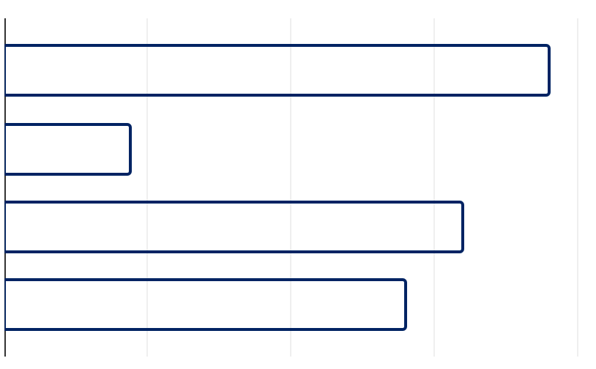
FINANCIAL MODEL
LEGAL
2024
40%
Jupiter is a gas giant and the biggest planet
2023
2022
HEALTH
60%
Saturn is a gas giant and has several rings
2021
0
25
50
75
100
Follow the link in the graph to modify its data and then paste the new one here. For more info, click here

Slide 21
PRICING STRATEGY
BASIC
STANDARD
ADVANCED
LEADING
20%
70%
10%
<1%
LEVEL: 1
LEVEL: 2
LEVEL: 3
LEVEL: 4
Mercury is the smallest planet of them all
Venus is the second planet from the Sun. It’s terribly hot
Earth is the only planet known to harbor life
Despite being red, Mars is actually a cold place

Slide 22
02
CONSULTING PROPOSAL
CONSULTING
You can enter a subtitle here if you need it
PROPOSAL

Slide 23
CONSULTING PROPOSAL
SERVICES
FEES
INVOICES
EXPENSES
MATERIALS
TERMS
Mercury is the smallest planet of them all
Venus has extremely
High temperatures
Earth is the only planet known to harbor life
Despite being red, Mars is actually a cold place
Jupiter is the biggest planet in the Solar System
Saturn is not the only planet with rings

Slide 24

A PICTURE IS WORTH A THOUSAND WORDS

Slide 25

A PICTURE REINFORCES THE CONCEPT
Images reveal large amounts of data, so remember: use an image instead of a long text. Your audience will appreciate it
PICTURE

Slide 26
ANSWERS AND SUPPORTIVE ARGUMENTS
State a question to support an answer. Example: how can the company reduce its cost by 10%?
REDUCE COSTS BY USD$5M THROUGH OPERATIONAL IMPROVEMENTS
SAVING USD$3M
SAVING USD$1M
SAVING USD$1M
Evaluate cost and service level
Select non-core functions
Choose one partner for each function
Design current processes
Current process to best-in-class benchmarks
Adopt best practices
Select and review current supplier costs
Evaluate cost of alternative suppliers
Negotiate supplier contracts options

Slide 27
INITIATIVE PRIORITIZATION MATRIX: IMPACT & EFFORT
IMPACT
EFFORT
An initiative with a high impact would mean one of the following:
- The initiative needs to happen in order to achieve the desired future state
- The initiative will significantly reduce the cost or increase our revenue
The “effort” criteria is assessed based on the following concepts:
- Ease of implementation
- Time frame required
- Resources required (number of people, capital investment, etc.)

Slide 28
PRIORITIZATION MATRIX
INITIATIVE
IMPACT
EFFORT
1
List all your potential initiatives
Very high
2
List all your potential initiatives
High
3
List all your potential initiatives
Low
4
List all your potential initiatives
High
5
List all your potential initiatives
Very high
6
List all your potential initiatives
High

Slide 29
03
CHANGE MANAGEMENT
CHANGE
MANAGEMENT
You can enter a subtitle here if you need it

Slide 30
CHANGE MANAGEMENT APPROACH
Do you know what helps you make your point clear?
Lists like this one:
They’re simple
You can organize your ideas clearly
You’ll never forget to buy milk!
And the most important thing: the audience won’t miss the point of your presentation

Slide 31
BUSINESS CASE
FIELD: OIL
CHARACTERISTIC | DESCRIPTION
VENUS | Venus has a beautiful name
EARTH | Earth is the third planet from the Sun
MARS | Despite being red, Mars is a cold place
JUPITER | Jupiter is a gas giant and the biggest planet
SATURN | Saturn has several rings and it’s of gas
Mercury is the closest planet to the Sun and the smallest one in the Solar System

Slide 32
COMPETITOR COMPARISON TABLE
ATTRIBUTE | MY BUSINESS | COMPETITOR A | COMPETITOR B | COMPETITOR C
PRICE | USD$300 | USD$320 | USD$280 | USD$350
QUALITY | High | Medium | Low | High
AGE | 18-50 | 20-40 | 18-45 | 40-50
REVIEW | Good | Bad | Average | Good
LOCATION | United States | Spain | Italy | England

Slide 33

TARGET
INTERESTS
SALEM WILSON
ABOUT HIM
Neptune is the farthest planet from the Sun. It's composed of gases
Interest 1
Interest 2
BUDGET
Interest 3
Interest 4
Age: 25 years old
Occupation: CEO
Location: Nicaragua
Hobbies: volunteering, reading, business
Art- 70%
Country - 25%
Interest 5
Interest 6
Church - 05%

Slide 34
IMPLEMENT, TRACK & MANAGE PROGRESS
MANAGE PROGRESS
PROGRESS
STATUS
LINK
VENUS
40%
www.yourlinkhere.com
MARS
35%
www.yourlinkhere.com
NEPTUNE
70%
www.yourlinkhere.com
JUPITER
15%
www.yourlinkhere.com
EARTH
85%
www.yourlinkhere.com
CERES
60%
www.yourlinkhere.com

Slide 35
CHANGE MANAGEMENT STRATEGY & PLAN
 | SIZE OF THE CHANGE
EXTREME | Name here | Name here | Name here | Name here | Name here
HIGH | Name here | Name here | Name here | Name here | Name here
MEDIUM | Name here | Name here | Name here | Name here | Name here
MODERATE | Name here | Name here | Name here | Name here | Name here
LOW | Name here | Name here | Name here | Name here | Name here
 | 1 TEAM | 1 UNIT | 1 DIVISION | HALF COMPANY | EXTREME
COMPLEXITY OF THE CHANGE

Slide 36
IMPLEMENTING CHANGES
04
IMPLEMENTING
You can enter a subtitle here if you need it
CHANGES

Slide 37
SALES & STRATEGY PLAN
1
2
3
4
5
IMPLEMENT THE PLAN
INTERNAL ANALYSIS
EXTERNAL ANALYSIS
SALES PLAN
SALES STRATEGY
Mercury is the closest planet to the Sun
Venus is the second planet from the Sun
Earth is the third planet from the Sun
Despite being red, Mars is a cold place
Jupiter is the biggest planet in the System

Slide 38
30,317,512
Big numbers catch your audience’s attention

Slide 39
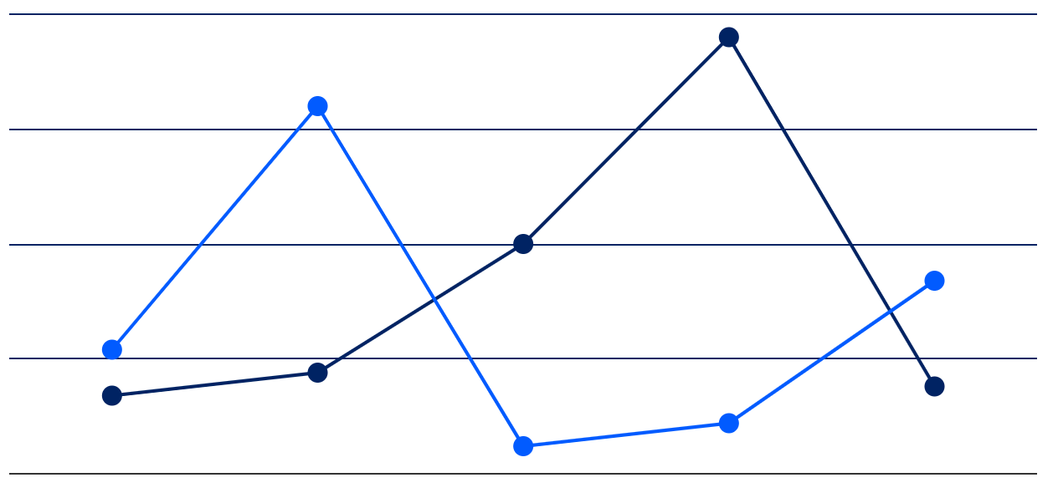
ABOUT THE TERMS OF THE AGREEMENT
100
TERM A
75
Saturn has several rings
50
25
TERM B
0
Neptune is very far from the Sun
Mercury
Venus
Earth
Mars
Jupiter
Follow the link in the graph to modify its data and then paste the new one here. For more info, click here

Slide 40
74%
$45,129
$23,587
$202,652
Mercury is a small planet
Venus is a hot planet
Earth is the planet with life
Mars was named after a god

Slide 41
MANAGEMENT APPROACH
Mercury is the closest planet to the Sun
Venus has extremely high temperatures
Earth is the third planet from the Sun
JANUARY
FEBRUARY
MARCH
APRIL
MAY
JUNE
Despite being red, Mars is actually a cold place
Jupiter is a gas giant and the biggest planet
Saturn is a gas giant and has several rings

Slide 42
STRATEGIC ALLIANCES
ALLIANCE #1
The Sun is the star that we all orbit
ALLIANCE #2
The Moon is Earth’s satellite
ALLIANCE #3
Pluto is now seen as a dwarf planet

Slide 43
ANSWERS & ARGUMENTS
FIRST OUTCOME
Mercury is the closest planet to the Sun
WRITE IN HERE YOUR QUESTION
WRITE IN HERE YOUR ANSWER
SECOND OUTCOME
Venus is the second planet from the Sun
THIRD OUTCOME
Earth is the third planet from the Sun

Slide 44
WATERFALL MANAGEMENT PLAN
REQUIREMENTS
Despite being red, Mars is actually a cold place
DESIGN
Jupiter is a gas giant and the biggest planet
IMPLEMENTATION
Saturn is a gas giant and has several rings
VERIFICATION
Neptune is the farthest planet from the Sun
MAINTENANCE
Mercury is the closest planet to the Sun

Slide 45
MATURITY MODEL
30%
50%
70%
BASIC
STANDARD
ADVANCED
Mercury is the closest planet to the Sun
Venus is the second planet from the Sun
Earth is the third planet from the Sun

Slide 46
PROFITABILITY RATIOS
WORST PEER
BEST PEER
RETURN ON SALES
10%
70%
90%
RETURN ON EQUITY
20%
35%
60%
RETURN ON NET ASSETS
5%
47%
85%
RETURN CAPITAL EMPLOYED
65%
80%
95%
RETURN ON FUNDS EMPLOYED
25%
45%
75%
Company A
Company B
Company C

Slide 47
TOP 10 QUESTIONS OF BUSINESS PLANS
1 | What is your situation?
2 | What is your vision?
3 | How to reach your vision?
4 | What do you offer?
5 | How big is the market?
6 | Who are the key players?
7 | How to make a difference?
8 | What is your marketing plan?
9 | What are your economics?
10 | What do you need to start?

Slide 48
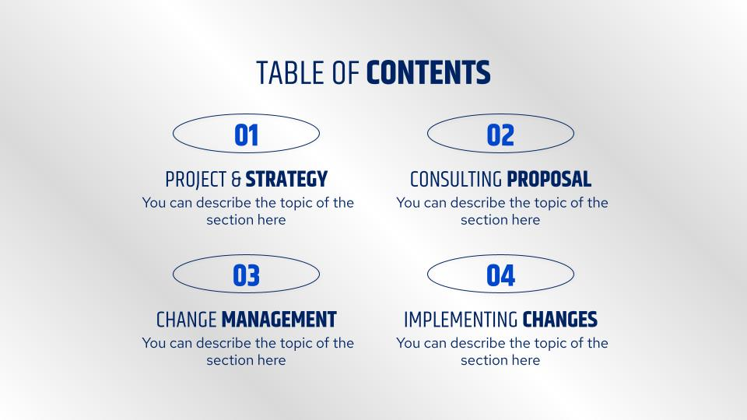
DEMO SOFTWARE & APP
You can replace the image on the screen with your own work. Just right-click on it and select “Replace image”

Slide 49


OUR TEAM
BRYAN HORSEMAN
ALLISON STANLEY
You can speak a bit about this person here
You can speak a bit about this person here

Slide 50
THANKS!
Does anyone have any questions?
addyouremail@freepik.com
+91 620 421 838
yourcompany.com
Please keep this slide as attribution

Slide 51
ICON PACK

Slide 52
ALTERNATIVE RESOURCES
Here’s an assortment of alternative resources whose style fits the one of this template:
VECTORS:
Gradient glassmorphism mobile app template
Gradient ui kit collection
Metallic texture silver gradient set

Slide 53
RESOURCES
Did you like the resources of this template? Get them for free at our other websites! PHOTOS:
Business people in conference room
Person working as part of company team
Medium shot woman working on laptop
Beautiful women working together in a startup company
People in business meeting high angle
VECTORS:
Gradient glassmorphism mobile app template
Gradient ui kit collection
Silver gradient collection
ICONS:
Startups | Filled

Slide 54
Instructions for use
If you have a free account, in order to use this template, you must credit Slidesgo by keeping the Thanks slide. Please refer to the next slide to read the instructions for premium users.
As a Free user, you are allowed to:
- Modify this template.
- Use it for both personal and commercial projects.
You are not allowed to:
- Sublicense, sell or rent any of Slidesgo Content (or a modified version of Slidesgo Content).
- Distribute Slidesgo Content unless it has been expressly authorized by Slidesgo.
- Include Slidesgo Content in an online or offline database or file.
- Offer Slidesgo templates (or modified versions of Slidesgo templates) for download.
- Acquire the copyright of Slidesgo Content.
For more information about editing slides, please read our FAQs or visit Slidesgo School:
https://slidesgo.com/faqs and https://slidesgo.com/slidesgo-school

Slide 55
Instructions for use (premium users)
As a Premium user, you can use this template without attributing Slidesgo or keeping the "Thanks" slide.
You are allowed to:
Modify this template.
Use it for both personal and commercial purposes.
Hide or delete the “Thanks” slide and the mention to Slidesgo in the credits.
Share this template in an editable format with people who are not part of your team.
You are not allowed to:
Sublicense, sell or rent this Slidesgo Template (or a modified version of this Slidesgo Template).
Distribute this Slidesgo Template (or a modified version of this Slidesgo Template) or include it in a database or in any other product or service that offers downloadable images, icons or presentations that may be subject to distribution or resale.
Use any of the elements that are part of this Slidesgo Template in an isolated and separated way from this Template.
Register any of the elements that are part of this template as a trademark or logo, or register it as a work in an intellectual property registry or similar.
For more information about editing slides, please read our FAQs or visit Slidesgo School:
https://slidesgo.com/faqs and https://slidesgo.com/slidesgo-school

Slide 56
Fonts & colors used
This presentation has been made using the following fonts:
Khand
(https://fonts.google.com/specimen/Khand)
Red Hat Text
(https://fonts.google.com/specimen/Red+Hat+Text)
#002363
#0047cc
#d9d9d9
#efefef
#ffffff

Slide 57

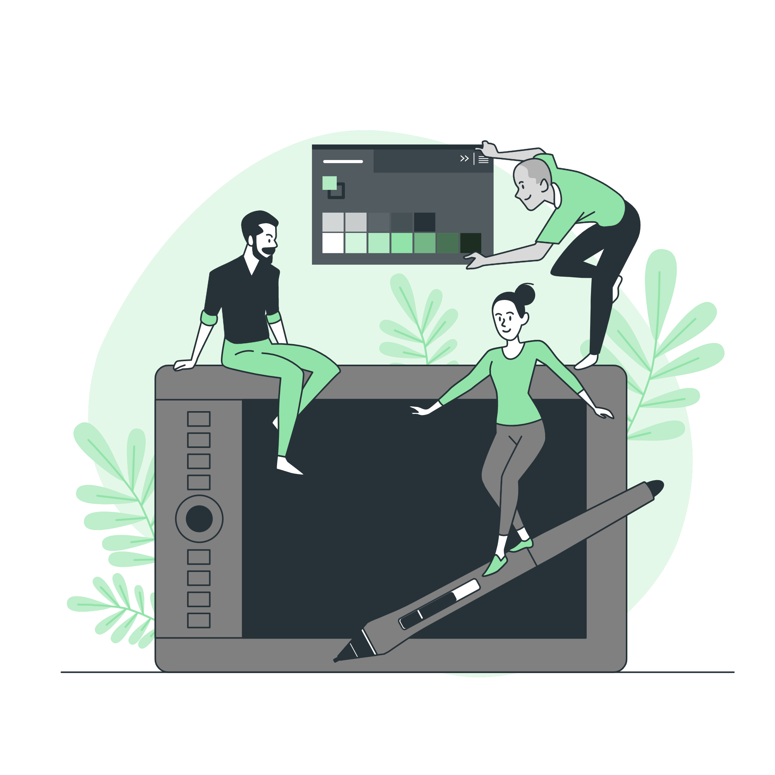



Storyset
Create your Story with our illustrated concepts. Choose the style you like the most, edit its colors, pick the background and layers you want to show and bring them to life with the animator panel! It will boost your presentation. Check out how it works.
Pana
Amico
Bro
Rafiki
Cuate

Slide 58
Use our editable graphic resources...
You can easily resize these resources without losing quality. To change the color, just ungroup the resource and click on the object you want to change. Then, click on the paint bucket and select the color you want. Group the resource again when you’re done. You can also look for more infographics on Slidesgo.

Slide 61
JANUARY
FEBRUARY
MARCH
APRIL
MAY
JUNE
PHASE 1
Task 1
Task 2
PHASE 2
Task 1
Task 2
JANUARY
FEBRUARY
MARCH
APRIL
PHASE 1
Task 1
Task 2

Slide 64
